Slide 1
IMS Project – 22MayEnable2
Toseef Mehdi

Slide 2
Introduction
The creation of an inventory management system with at least three tables:
Customers
Items
Orders
CRUD functionality for all three tables
User interaction through Command Line Interface (CLI)
Code fully integrated into a version control system (Github) using Main/Dev/Feature model
Documentation:
Jira board with epics, tasks and user stories
ERDs & UML showing the database relationships
Risk assessment including a matrix
MoSCoW document

Slide 3
Technologies used
Programs covered over past 5 weeks:
Git/Github – version control system
Jira – organise project using Kanban board via user stories, tasks and sprints
MySQL – create a database
Java (eclipse) – coding
Maven/Junit/Mockito – used for testing

Slide 4
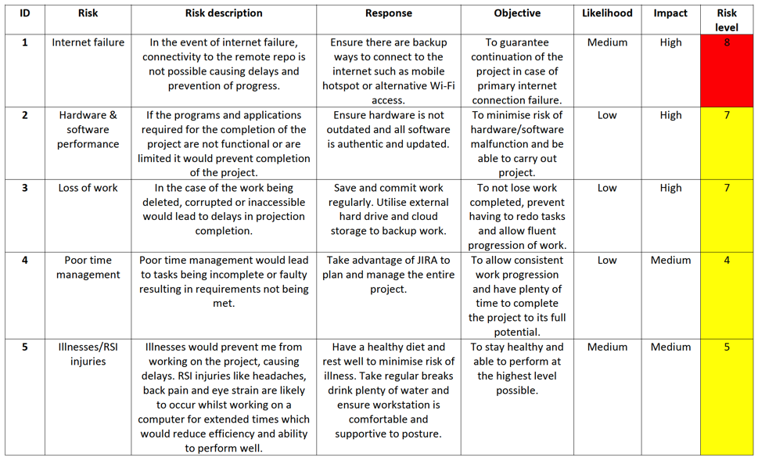
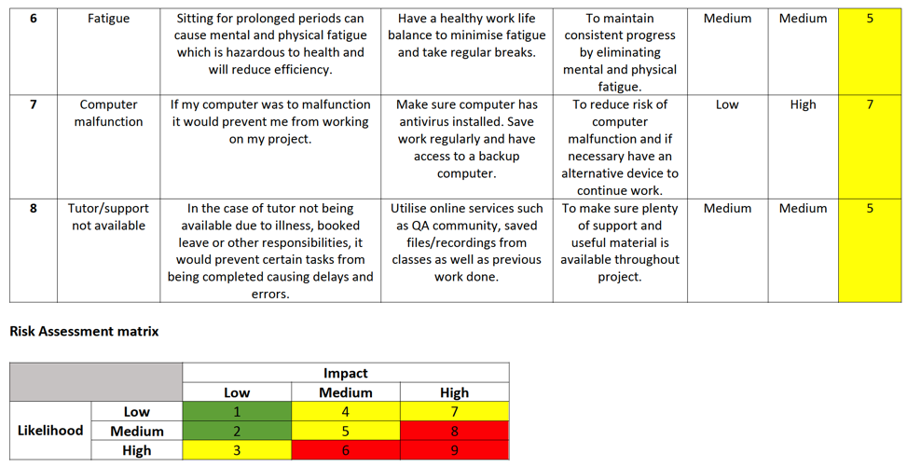
Risk Assessment

Slide 5
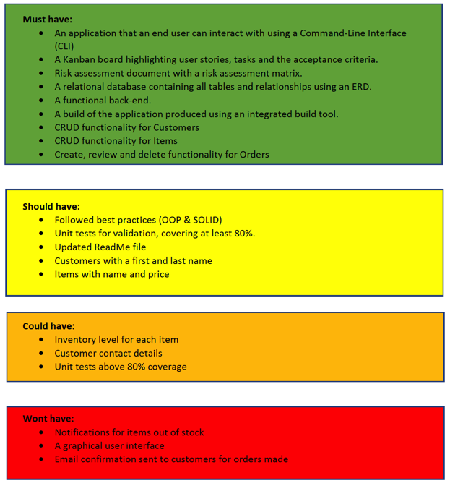
MoSCoW Document

Slide 6
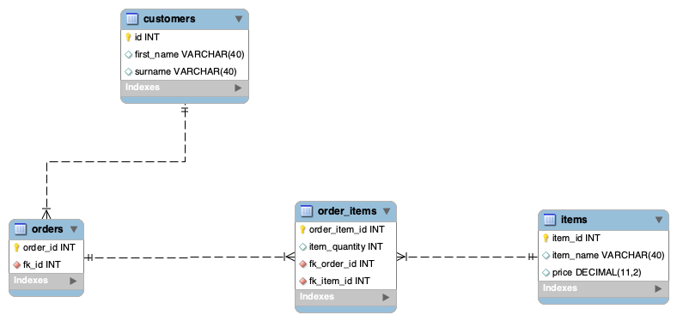
ERD

Slide 7
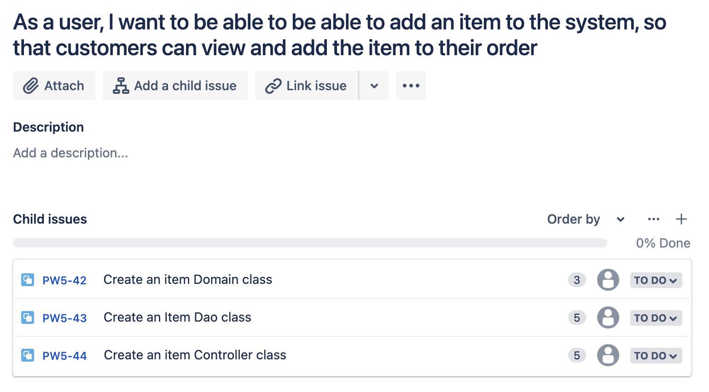
User Stories with tasks

Slide 8
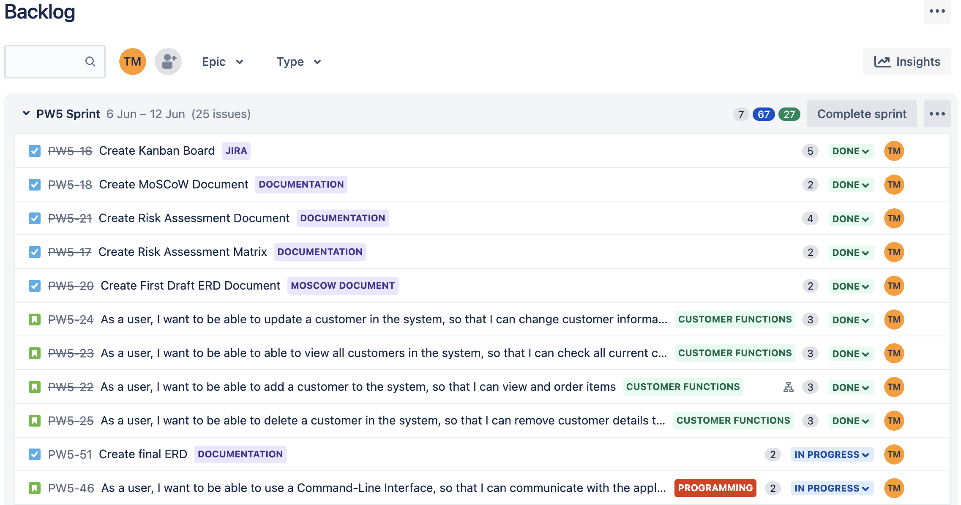
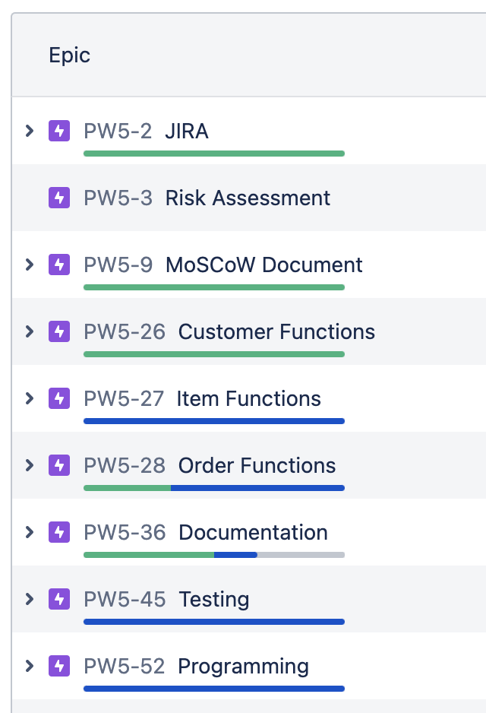
Stories and Tasks with Epics Applied

Slide 9
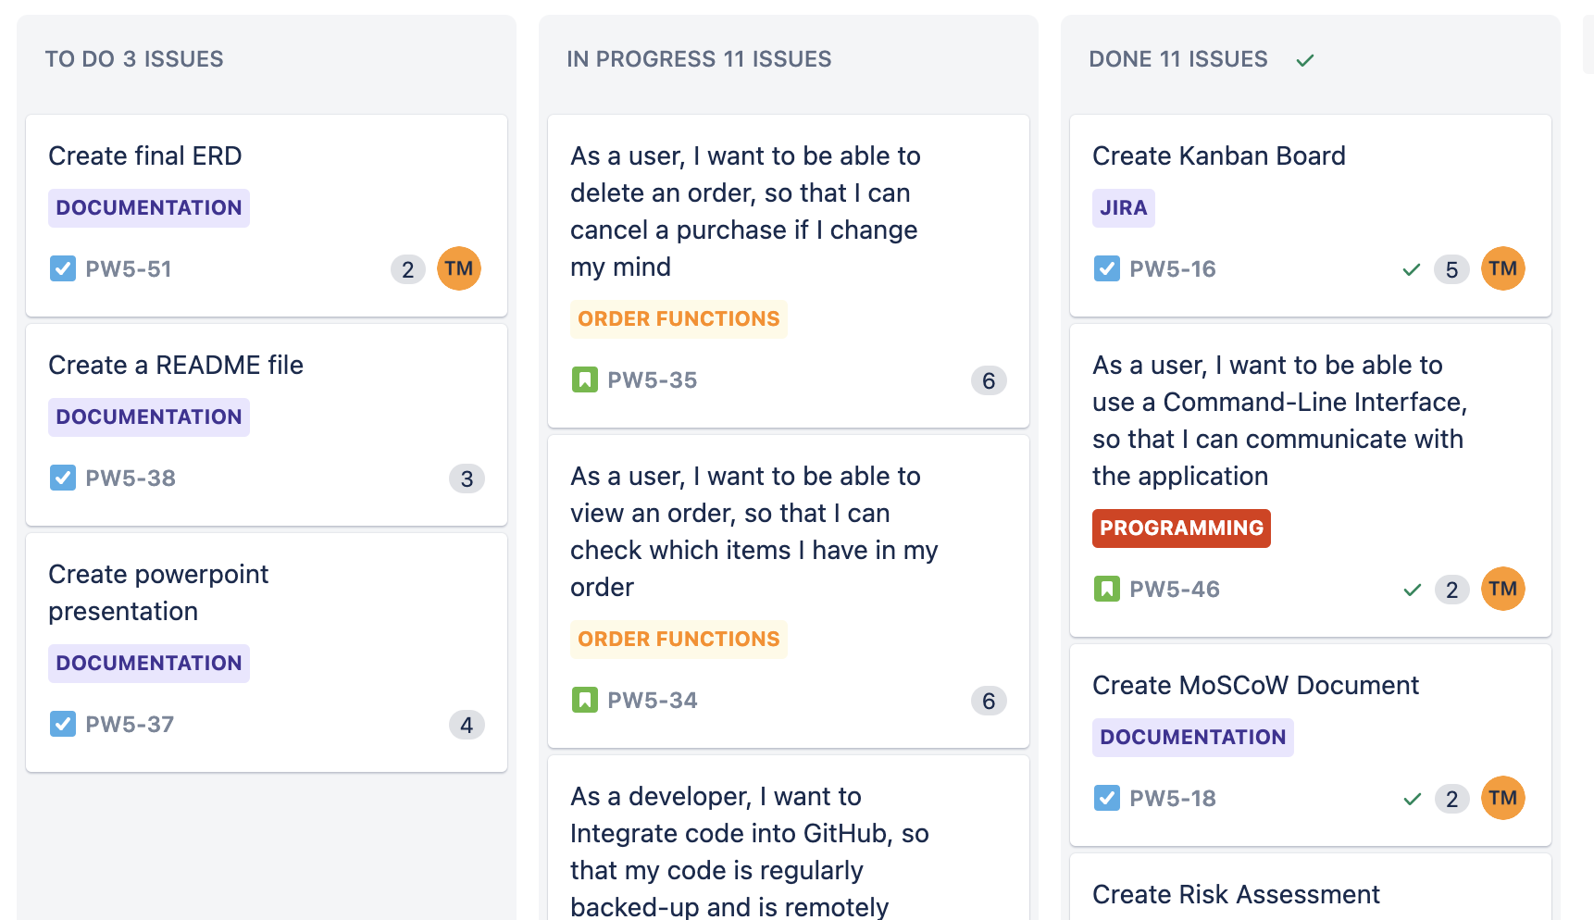
Kanban Board

Slide 10
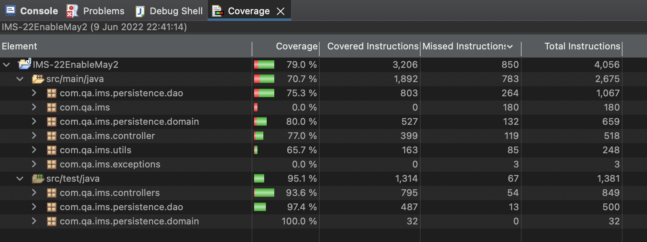
Testing
I was able to achieve a test coverage of 79%
The failed tests varied for the CRUD functions in each table class

Slide 11
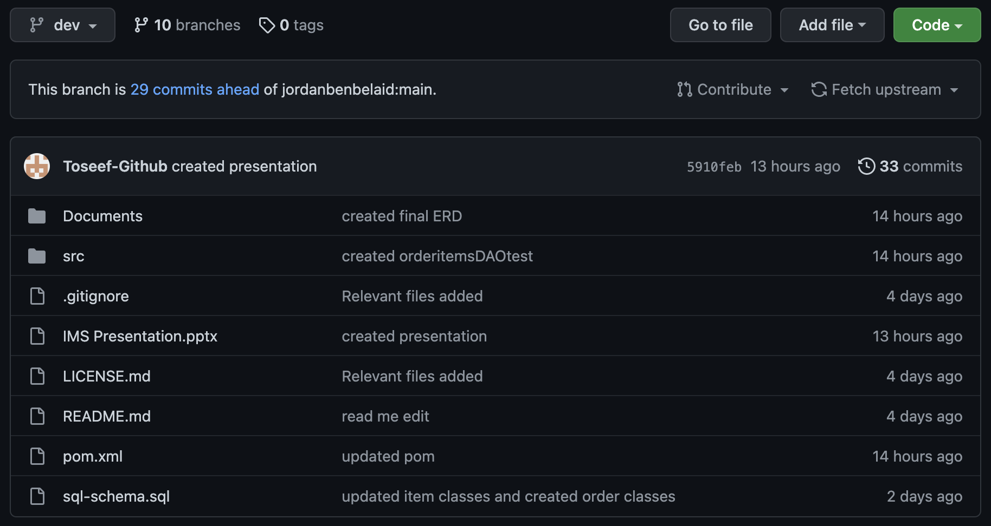
Project reflection
I was able to complete:
CRUD for all tables
Input via CLI
Testing
ERD
Unable to achieve:
Smart commits
UML
Coverage above 80% for tests

Slide 12
Conclusion
As this was my first project I would conclude that it has been a success as the Minimum Viable Product (MVP) has been achieved.
I would improve my code so that it is more efficient.
would also spend more time on testing to have coverage above 80%.
I would also use Github more effectively as I was unable to update it as consistently as I would have liked.

